Slide 1
String Based C program
By
Kishore M
ECE
AAACET

Slide 2

Problem
Write a C program to create a list of objects with the following items in it: Laptop, Bag, Pencil, Pen, Paper, Book, Phone, Cable.
Perform the following with respect to the list created.
a) The list should be displayed in an alphabetical add.
b) The user should be able to search for a particular object from that list and view it.
c) After the searched object has been displayed, it should be removed from the list and the list has to be updated and displayed.
d) For example, if the list had 5 objects in the first place, it should have only 4 objects after the search.

Slide 3
Solution Explanation
The program is available in another file “Coding.rtf”
For getting a list of object from the user, I use the array of string concept.
Syntax of the array of string is
string [100] [100];
Where string is variable and 100 is size of array elements.
And I use gets() function to get string from a user.

Slide 4
Problem
I use a basic selection sorting method using strcmp and strcpy functions.
These functions are used to compare and copy the string values.
Then I print the ordered objects in the string.
Next I get the item from the user to search.

Slide 5
Problem
For Searching operation again I use a strcmp function.
I comparing all the string to the finding object to found the location of the object.
Then It print the location using the printf function.
Next searched item is disappeared or deleted and the remaining list of objects are displayed.

Slide 6
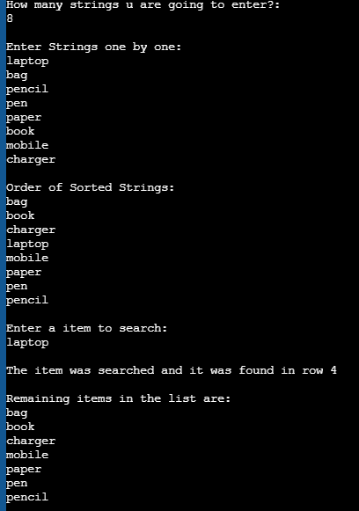
Output
The output for this problem is shown in figure.

Slide 7
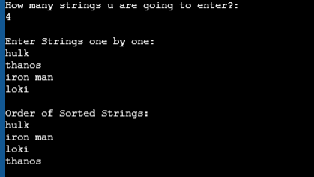
Test cases
You also use the spaces in between the objects. So no need to worry about the object with space.
Eg: Iron man

Slide 8
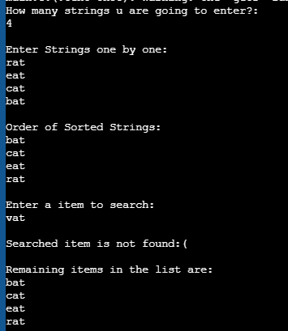
Test cases
In case if you search a object that is not present in a list it prints the Searched item is not found.
And it prints the remaining all objects in the list.

Slide 9
Test cases
In case if you give a object length above limit. It produces some case of problems in execution.
So try to use within a limit. Or increase a limit value.

Slide 10
Thankyou ☺

